Slide 1
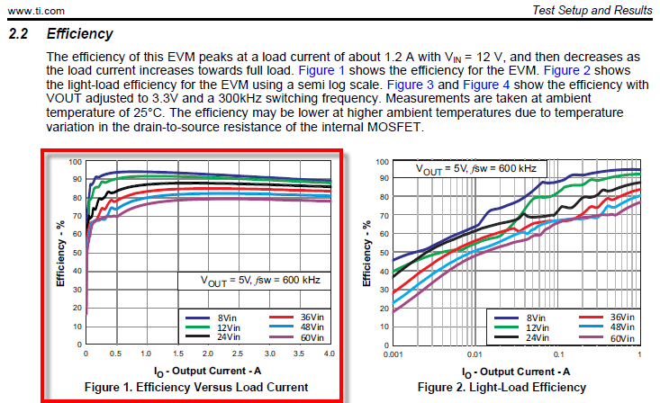
Goal

Slide 2
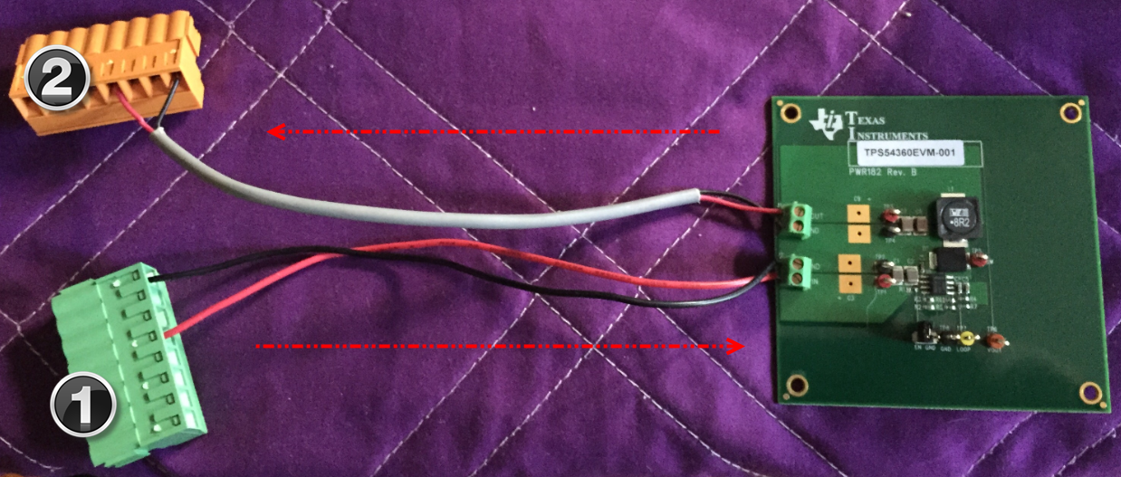
DUT – Not Connected to Instrumentation

Slide 3
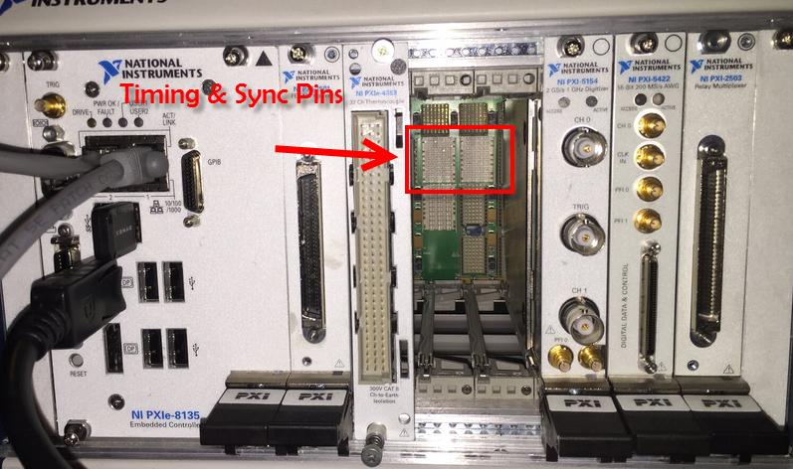
Triggering Backplane - Photo

Slide 4
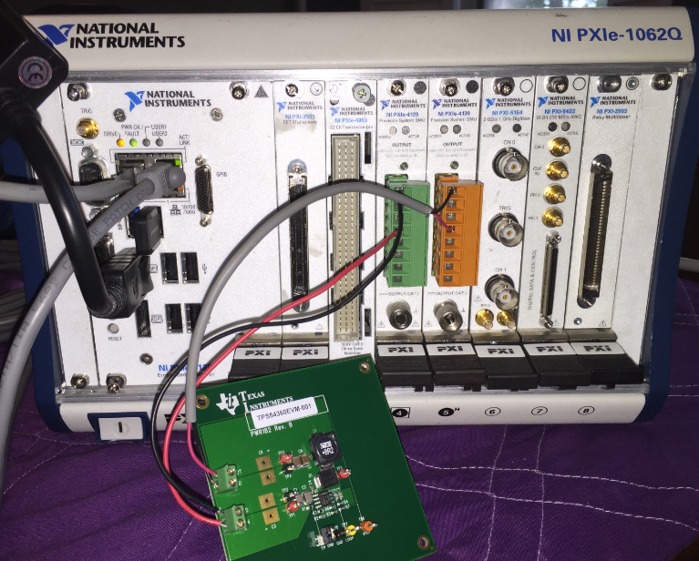
DUT – Connected to Instrumentation

Slide 5
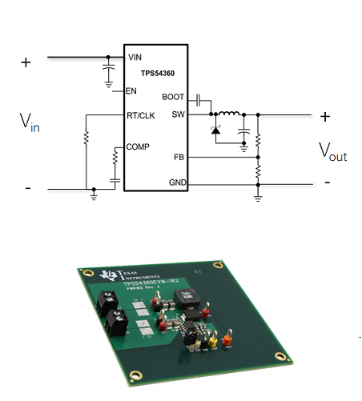
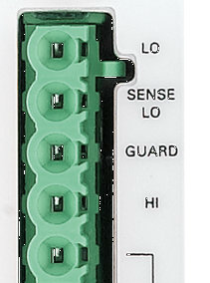
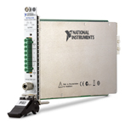
Wiring to TPS54360
V _{IN} = 8V – 60V
I _{OUT} = 0A – 3A
V _{OUT} = 5V

Slide 6

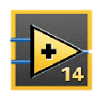
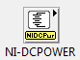
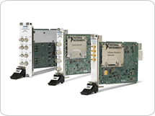
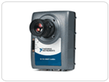
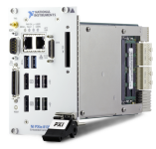
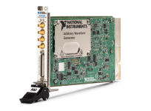
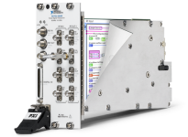
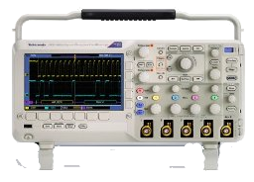
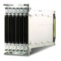
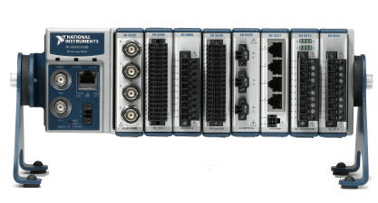
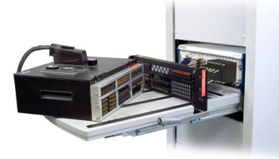
Components of an Automated Test System
SOFTWARE
NI TestStand
Test Management, Test Deployment
Test Management Software
Test Development Software
NI LabVIEW
LabWindows™/CVI
Other Software
Measurement Studio, Visual Studio.NET™, …
IVI, VISA, NI-DAQ, NI-DMM, NI-SCOPE, NI-FGEN, NI-HSDIO, …
Drivers, Services, Hardware Abstraction
HARDWARE
PC or Embedded Controller
PXI Chassis
Switching
Signal Generation
RF Measurements
Bus Interfaces (GPIB/LXI/Serial)
Fixturing/ Mass Interconnects
Notes:
The best way to develop an automated test system is to follow a modular software architecture. Modularity in test system design help you increase the maintainability and reusability of your test system components. In particular, a modular test software architecture should be divided into four layers:
Fixturing/Mass Interconnects: At the lowest level, the first component is having well designed mass interconnects or fixturing. This allows test operators to quickly and reliably connect and disconnect each device as they come off the assembly line.
Hardware, Drivers, Services: Going one level higher, the next layer is the actual hardware and their respective drivers that you’ll use to take measurements from your device under test (DUT). This includes your computer or embedded PXI controller, the PXI chassis that contains your switching, signal generation, RF or other modules, and any bench-top instruments that you have in your system.
Test Development Software: In light blue, you then have your tests, potentially developed using a number of different programming languages. When developing software to control your tests you should focus on modularity as well. Each test should be a modular piece of code that can be reused and maintained independently.
Test Management Software: The modularization of your tests poses the challenge of bringing together all these different tests to create a test system. The top layer is the test management software where you integrate the different pieces of a test system, control the use of instrumentation resources, log results to reports and databases as well as integrate with other organization wide enterprise systems. The industry leader in test management software is NI TestStand.

Slide 7
Appendix

Slide 8
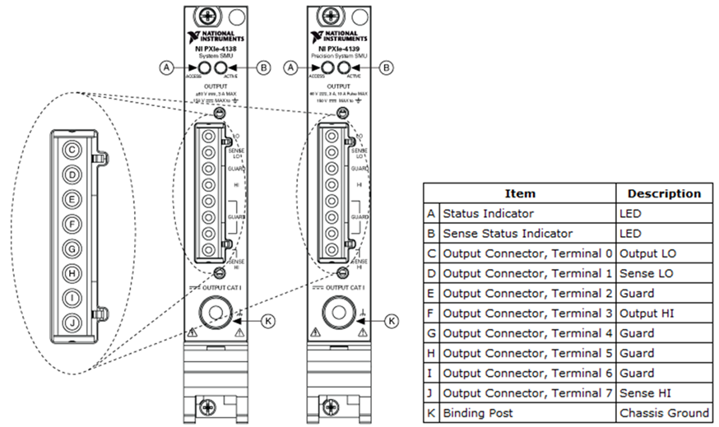
PXIe-4138/9 Connections Break-out

Slide 9
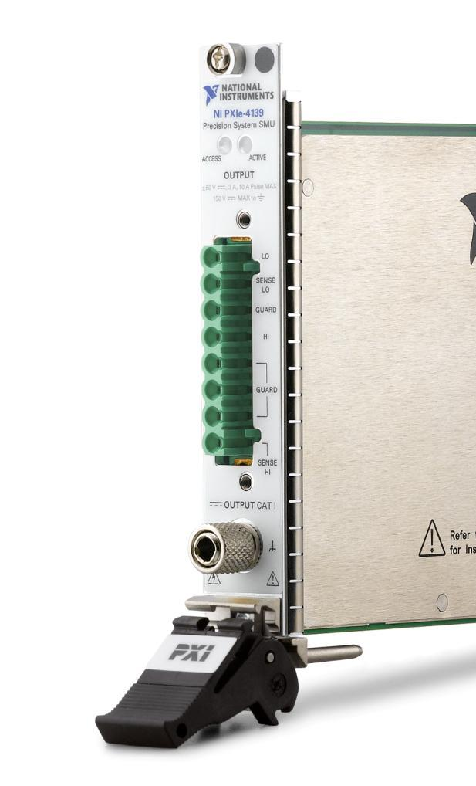
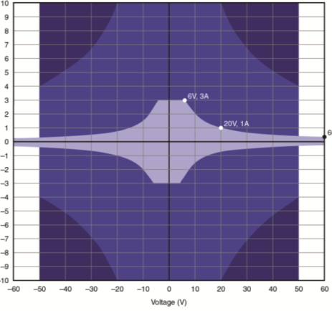
NI 4138/9 System SMUs High Power, High Precision, High Speed
Max Power:
20 W DC (60 V or 3 A)
500 W Pulse*
Max Sensitivity:
100 fA*
100 nV*
Max Speed:
Sampling 1.8 MS/s
Update: 100 kS/s
NI SourceAdapt™ Technology*
Extended Range Pulsing*
Hardware timing & triggering
*only available on 4139

Slide 10
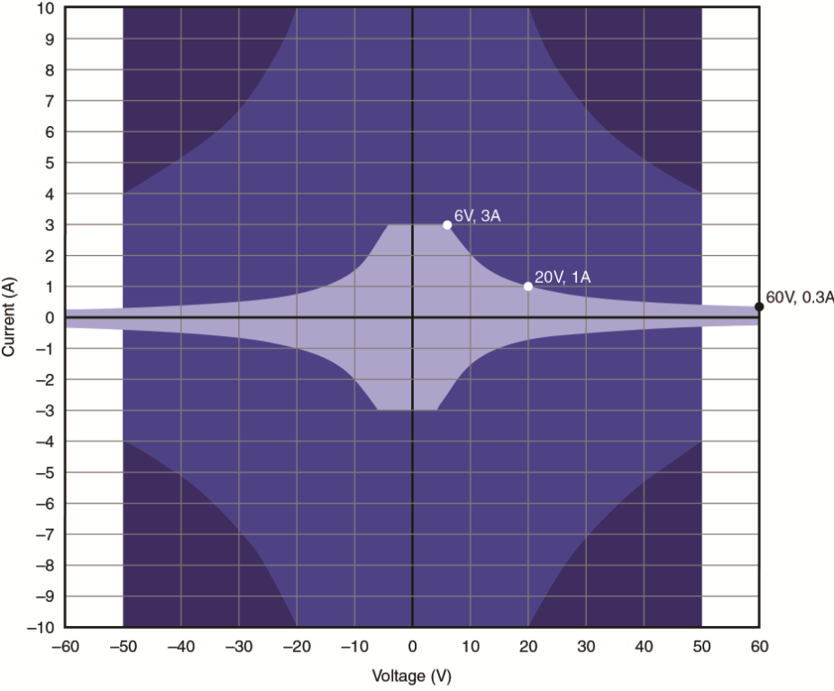
NI 4139 Extended Range Pulsing
1
DC region
2
3
Pulse only
3
Max instantaneous power: 500 W
Note duty cycle limitations in specs
2
Max instantaneous power: 200 W
1
pulse width
pulse off time
Min pulse width: 50 µs
1
Notes:
A new feature of the 4139 is the extended pulse boundary. You may be familiar with the standard DC power boundary that shows you the current and voltage combinations you can source or sink from the SMU. The extended pulse boundary is similar in that you can source/sink power, but only in short pulses instead of as constant DC source. This feature is very useful in that it allows you to perform high power IV sweeps with a single SMU, and minimize the heat dissipation through the DUT. Please note limitations such as max duty cycle and pulse width when operating the SMU in the extended pulse boundary – see specs for detailed info.

Slide 11
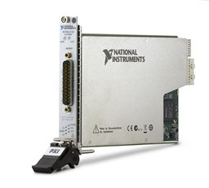
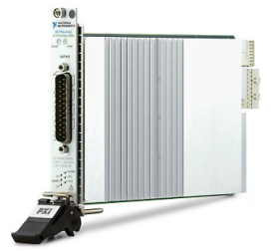
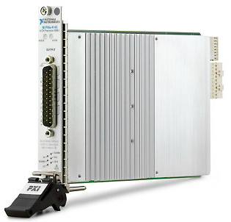
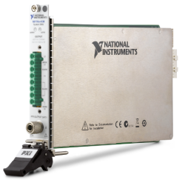
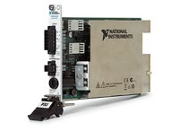
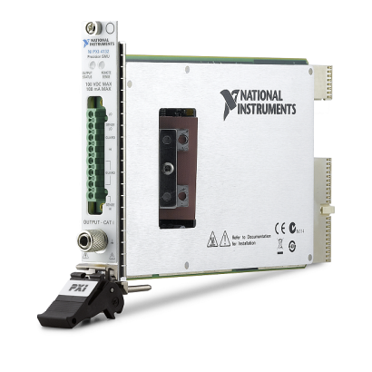
 | NI PXI-4130 Power SMU | NI PXI-4132 Precision SMU | NI PXIe-414x Low Cost SMUs | NI PXIe-414x Precision SMUs | NI PXIe-4138/9 System SMUs
Description / Applications | High power IV sweeps Component characterization General purpose SMU | Low-power leakage test Semiconductor characterization | 4-SMU Channels Semiconductor High pin count test | 4-SMU Channels Semiconductor High pin count test | Wide IV sweeps High power pulsing High precision measurements
Max Voltage | ± 20V | ± 100V | ± 10 V – 24 V | ± 24V | ± 60 V
Max Current | ± 2A | ± 100mA | ± 100 mA – 500 mA | ± 150mA | ± 3 A, 10 A Pulse*
Max Power | 40 W | 2 W | 1-3 W | 1-3 W | 20 W, 500 W Pulse*
Max Sampling | 3 kS/s | 4.2 kS/s | 600 kS/s | 600 kS/s | 1.8 MS/s
Max Update | 3 kS/s | 3.5 kS/s | 100 kS/s | 100 kS/s | 100 kS/s
Current Sensitivity | 1 nA | 10pA | 100-150 pA | 10-15 pA | 100 fA*
Guarding | No | Yes | Yes | Yes | Yes
Timing/Triggering | Software Only | SW or HW | SW or HW | SW or HW | SW or HW
SourceAdapt? | No | No | No | Yes | *PXIe-4139 only
Channel Density | 17 | 17 | 68 | 68 | 17
Output Disconnect | No | Yes | No | No | Yes

Slide 12
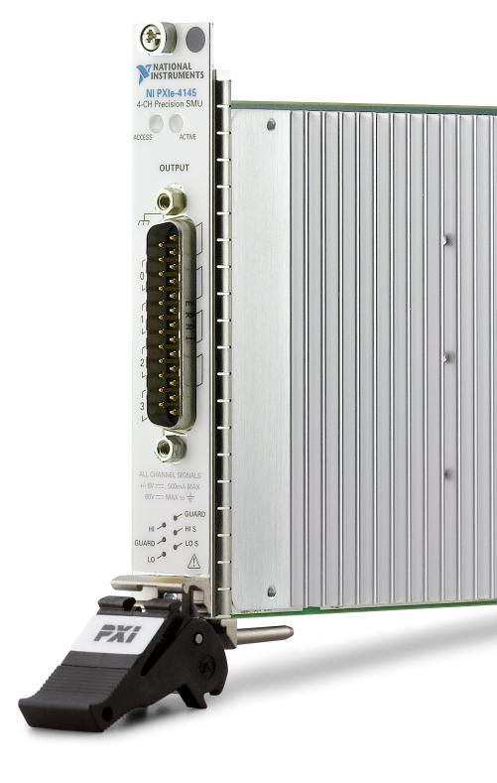
PXIe-414x High Density SMU Family
4-channel Precision SMUs
IV boundary
10 V, 100 mA (4140/1)
24 V, 150 mA (4142/3)
6 V, 500 mA (4144/5)
Current Sensitivity
10-15 pA for 4141/3/5
100-150 pA for 4140/2/4
Speed
600 kS/s maximum sampling
100 kS/s update rate
SourceAdapt Technology
68 channels in a PXI chassis
500mA
150mA
100mA
6V
10V
24V
PXIe-4141 10V, 100mA
PXIe-4143 24V, 150mA
PXIe-4145 6V, 500mA

Slide 13


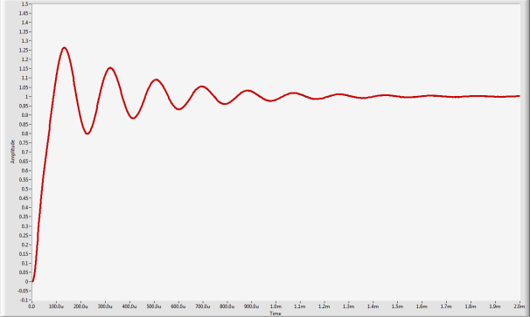
NI SourceAdapt™ Technology Limitations of Traditional SMUs
Implemented with
Analog Hardware Components
V-I
Control
DAC
Set Point
load
ADC
Digital
Analog
Traditional SMU
Notes:
Detailed SourceAdapt info:
Video: http://www.ni.com/video/2355/en/
Whitepaper: http://www.ni.com/white-paper/13093/en/
Demo available on NI Talk – Precision DC Sales Resources
SMUs of course employ a closed control loop. That is if you source a value to a DUT, SMU wants to make sure that the programmed value is actually at the DUT so it uses a feedback control loop to make sure that happens.
For a tradition SMU, the control loop is implemented in the hardware.. Capacitors, op-amps and resistors. That in itself is not really a problem.
But the problem is that when you connect SMU to a load, the load itself becomes part of the control loop and the behavior of the control loop, or how the SMU responds is now a function of the load. Again in the case of MEMs gyros, capacitive elements can cause SMU in voltage source mode to give non ideal responses.
Perhaps the biggest problem is that once you buy an SMU you can’t change it. If it works well with your load.. (hopefully that is the case).. You’re fine.
But if non ideal behavior with a particular SMU and load combination, there are not a whole lot you can do (you can tweak it by adding resistors etc. but that only go so far).

Slide 14

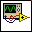
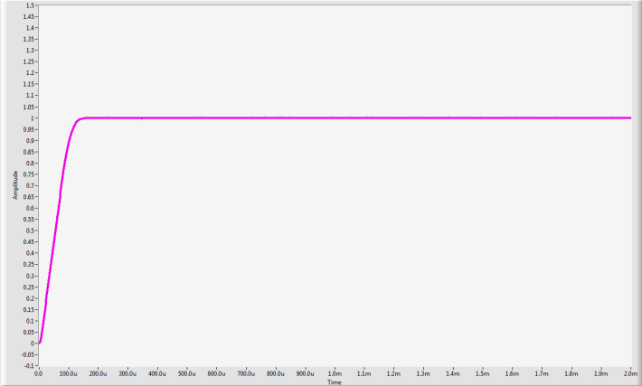
NI SourceAdapt™ Technology
Moved into Digital Domain
DAC
FPGA
Control
Output
load
ADC
Set Point
Digital
Analog
NI SourceAdapt Technology
Notes:
At NI we have been working hard to deal with this issue and last year we release a revolutionary SMU that employs a control loop in the digital domain. We called it SourceAdapt Technology.
With SourceAdapt technology we essentially created a programmable control loop by implementing all control loop functions inside an FPGA.
In fact we can do this and our competitors can’t because we are leaders in leveraging FPGA technologies and in fact we prototyped this using LabVIEW FPGA.
Now since the control loop is in digital domain.. It is totally programmable and we can configure it to provide an ideal response for any given load.

